Slide 1




Rajalakshmi Engineering College
SMART SAVER AUTOMATION
Introduction to Robotic Process Automation
Register No. 220701322
Name. VINOTH J
Guide Name. Ms. U Farjana
CSE-E 3rd YEAR

Slide 2

ABSTRACT
Smart Saver Automation is an innovative robotic process automation (RPA) solution developed in UiPath Studio to automate money transfers across accounts on a monthly basis. Designed to facilitate financial planning and streamline routine banking tasks, the automation enables users to efficiently allocate funds from their salary account to other accounts, such as those belonging to family members (e.g., father, mother, son) or personal savings and trading accounts.

Slide 3
Need for the Proposed System
Managing personal finances effectively can be a challenging and time-consuming task, especially for individuals with multiple financial obligations. Routine money transfers, such as allocating funds to family members, savings accounts, or investment portfolios, often require manual intervention, making the process prone to delays and errors.
The Smart Saver Automation project addresses these challenges by leveraging the capabilities of UiPath Studio to create a fully automated solution for financial transactions.

Slide 4
Advantages of the Proposed System
We're studying the market for a new product, analyzing consumer trends and competition. Our goal is to identify opportunities and challenges, gain valuable insights, and position the product for success.

Slide 5
Literature Survey
Robotic Process Automation: The Next Transformation Lever for Shared Services
Willcocks, L., Lacity, M., & Craig, A. (2015)
Advantages:
Highlights the efficiency gains from RPA, including time savings and reduction of human errors.
Demonstrates how RPA can automate repetitive financial tasks, such as transaction processing and account reconciliation.
Discusses the scalability of RPA for various use cases, making it applicable to personal finance management.

Slide 6
Literature Survey
Robotic Process Automation: The Next Transformation Lever for Shared Services
Willcocks, L., Lacity, M., & Craig, A. (2015)
Disadvantages:
Focuses primarily on enterprise applications; lacks direct applicability to individual-level financial tasks.
Does not address specific challenges of integrating RPA with online banking systems.
Limited discussion on security measures tailored for personal finance.

Slide 7
Main Objective
The objective of the Smart Saver Automation Project is to develop a robust and user-friendly robotic process automation (RPA) solution using UiPath Studio to automate the recurring process of transferring funds from a user’s current account to designated accounts.

Slide 8
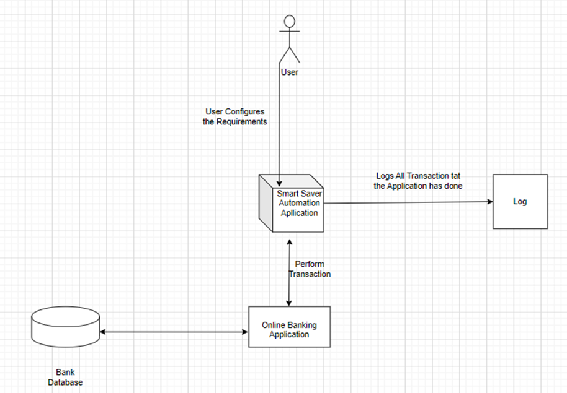
Architecture

Slide 9
System Requirements
1. Hardware Requirements
To run and deploy the Smart Saver Automation system efficiently, the following hardware specifications are recommended:
Processor : Intel Core i3 or equivalent
RAM : 4 GB
Network : Stable internet connection (1 Mbps)
Peripherals : Keyboard and mouse
2. Software Requirements
The software stack required for development, deployment, and usage of the Smart Saver Automation system includes:
Operating System : Windows 10 (64-bit) or higher
Automation Platform : UiPath Studio and UiPath Orchestrator
Frameworks/APIs : .NET Framework 4.7.2 or higher
Browser : Google Chrome or Microsoft Edge

Slide 10
Functional Description
Module 1: Getting Balance Using Web Scraping
Short Description:
The Getting Balance Module retrieves the current account balance by logging into the user’s online banking portal through a secure, automated web scraping process. The retrieved balance is stored for further use in fund allocation or balance verification workflows.

Slide 11
Functional Description
Module 2: Transferring Balance
Short Description:
This module automates the transfer of funds from the user's account to predefined recipients, such as family members, savings accounts, or trading platforms, based on user-configured rules.

Slide 12
Process Design
Main Process: Smart Saver Automation
The main process governs the flow of automation to detect account balance, process fund transfers, and ensure smooth operation with error handling. It integrates two core subprocesses: Getting Balance and Transferring Balance, while maintaining logging mechanisms.
Sub Process 1: Getting Balance
Objective: Retrieve the user's current account balance securely via web scraping.
Sub Process 2: Transferring Balance
Objective: Distribute funds to predefined recipients (e.g., family members, savings accounts, trading platforms) based on user-configured rules.

Slide 13
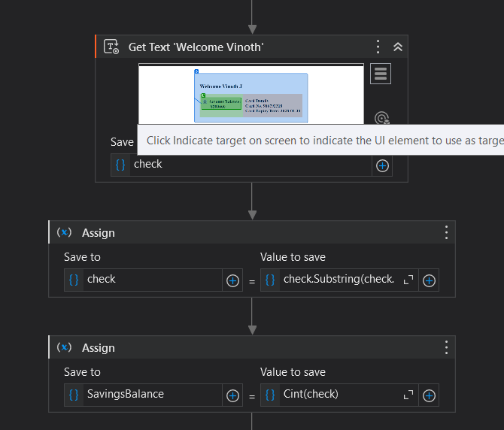
Implementation
Module 1: Getting Balance Using Web Scraping
Description
The Getting Balance Module automates the process of securely logging into a bank's online portal, scraping the account balance, and storing it for further operations. The implementation leverages UiPath Studio to automate web interactions.

Slide 14
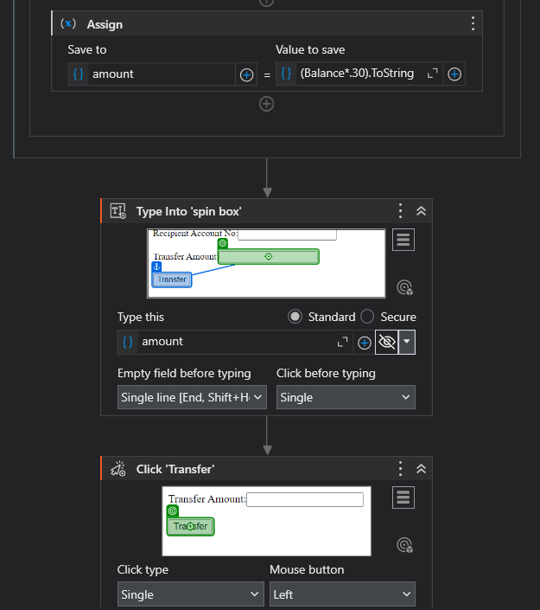
Implementation
Module 2: Transferring Balance
Description
The Transferring Balance Module automates the process of distributing funds to predefined recipients using the bank's online portal. This module adheres to user-configured rules for transfers and ensures secure execution of transactions.

Slide 15
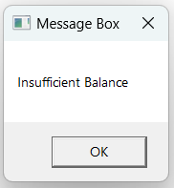
Testing
Description
Testing ensures that both modules—Getting Balance Using Web Scraping and Transferring Balance—are working as expected.
When insufficient balance in bank account transfer is not done

Slide 16
Conclusions
The Smart Saver Automation Project demonstrates the potential of Robotic Process Automation (RPA) to transform personal finance management by automating recurring tasks, such as monthly fund transfers. By leveraging UiPath Studio, the system offers a secure, efficient, and user-friendly solution that addresses the limitations of existing financial tools and manual processes.
In conclusion, the Smart Saver Automation System not only simplifies financial management but also empowers users to make informed decisions, save time, and enhance their financial well-being. It serves as a practical and innovative example of how automation can be harnessed to improve everyday life.

Slide 17
Future Enhancement
The Smart Saver Automation system is designed to provide a streamlined and secure way of automating financial transactions. However, there are several potential future enhancements that could improve the system’s functionality, scalability, and user experience:
1. Multi-Bank Support
2. Enhanced Security Measures
3.Transaction History Tracking & Reporting
4.Customizable Transfer Rules

Slide 18
References
1. Willcocks, L., Lacity, M., & Craig, A. (2015). Robotic Process Automation: The Next Transformation Lever for Shared Services. LSE Research Online.
- Discusses the potential of RPA in transforming business processes, including financial services.
2. Choi, H., & Devaney, S. (2020). Adoption of Personal Finance Tools and Their Impact on Financial Planning. Journal of Financial Planning, 33(4), 45-53.
- Explores the role of personal finance management tools in improving user financial behavior.
3. Gomber, P., Kauffman, R. J., Parker, C., & Weber, B. W. (2018). On the Fintech Revolution: Interpreting the Forces of Innovation, Disruption, and Transformation in Financial Services. Journal of Management Information Systems, 35(1), 220-265.

Slide 19


Timmerman Industries
Thank You
02 May, 2024

